Slide 1

Matrix Mania

Slide 2


Contents
Home Automation | 3
Circuit Diagram | 4
Sensors Used | 7
Components Used | 8
User Interface | 9
Coding
Interactive Chat Bot | 5
Our Goals and Vision | 6
About Us | 7

Slide 3

Easily manages appliances and systems from single interface
Features of our home Automation
Optimize energy usage by automating climate control and lightning
Monitor and secure your home with smart locks and camera
Personalized settings without manual adjustments
Centralized control contributes to overall cost saving and energy conservation

Slide 4
Circuit Diagram
Graphical representation of an electric circuits

Slide 5
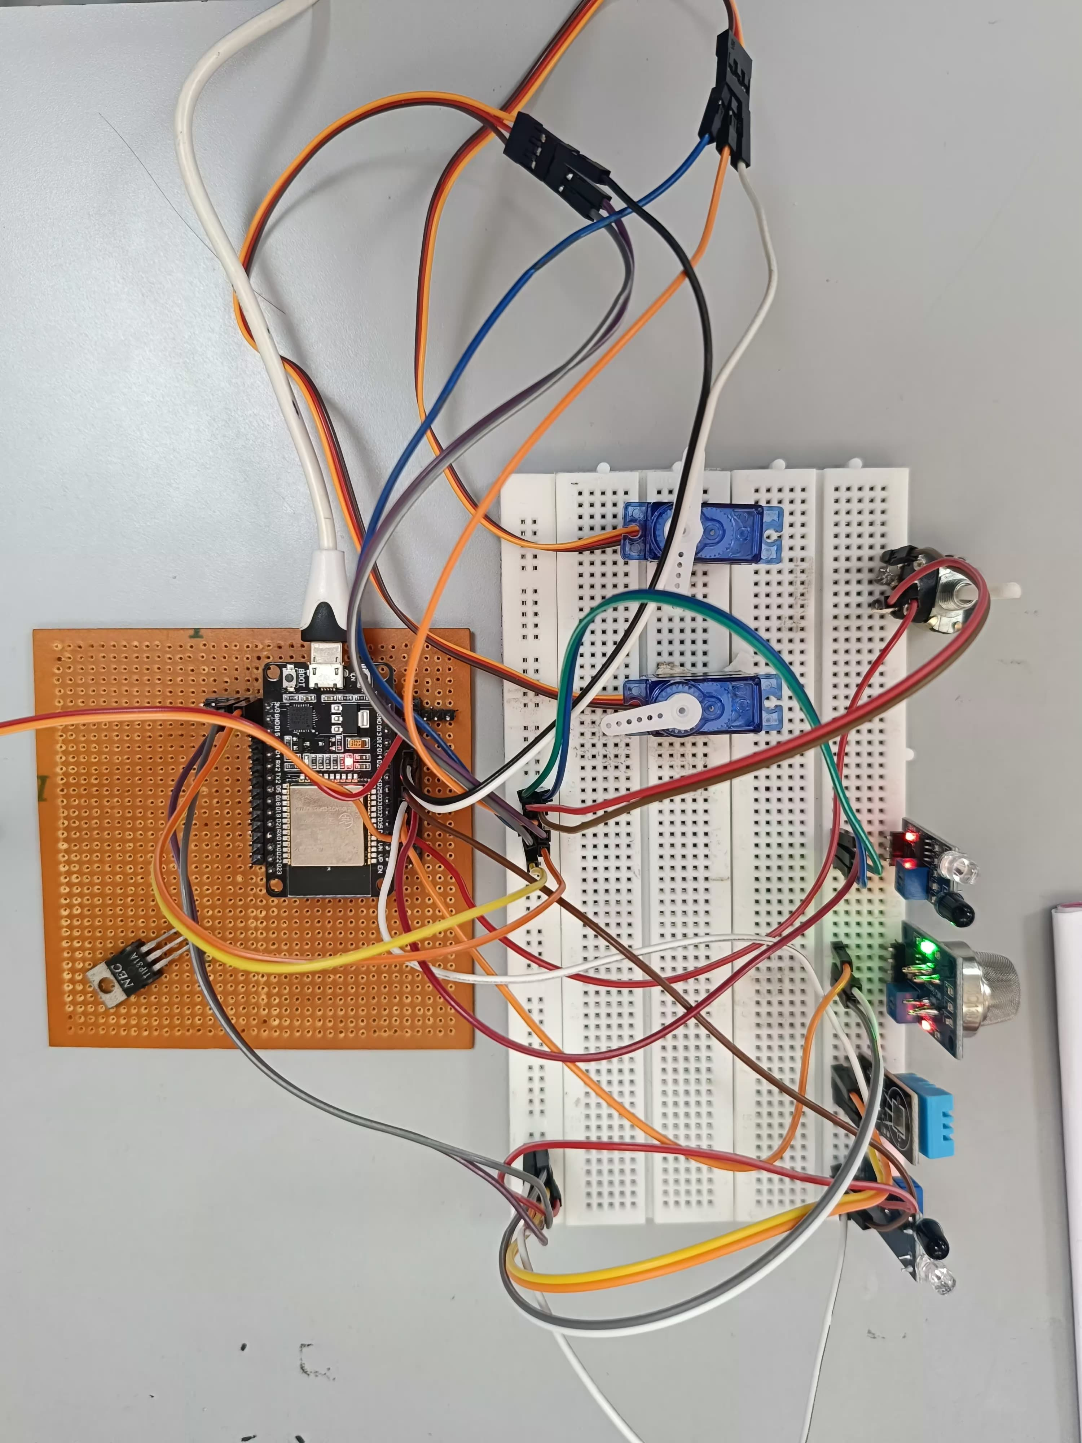
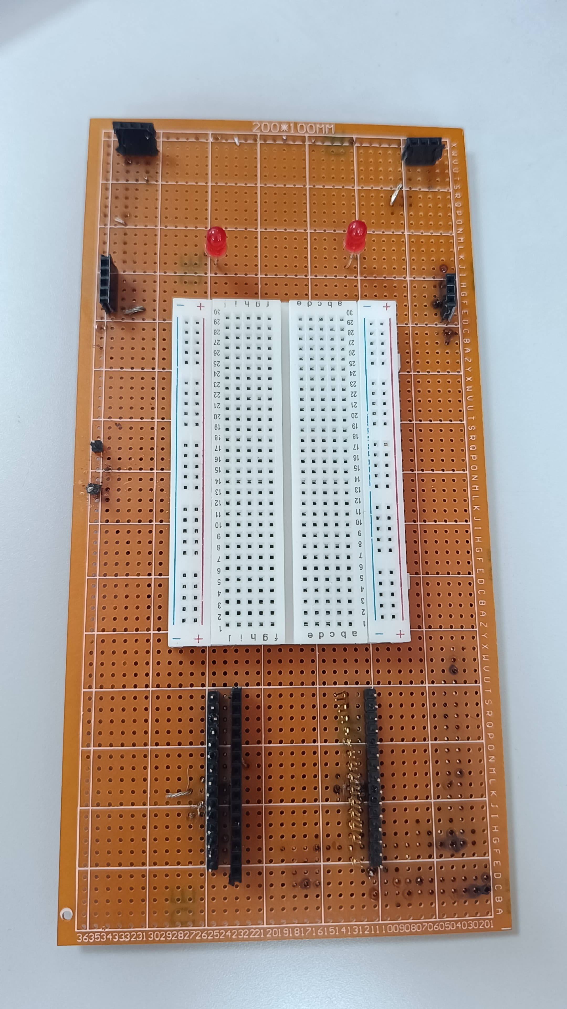

Slide 6
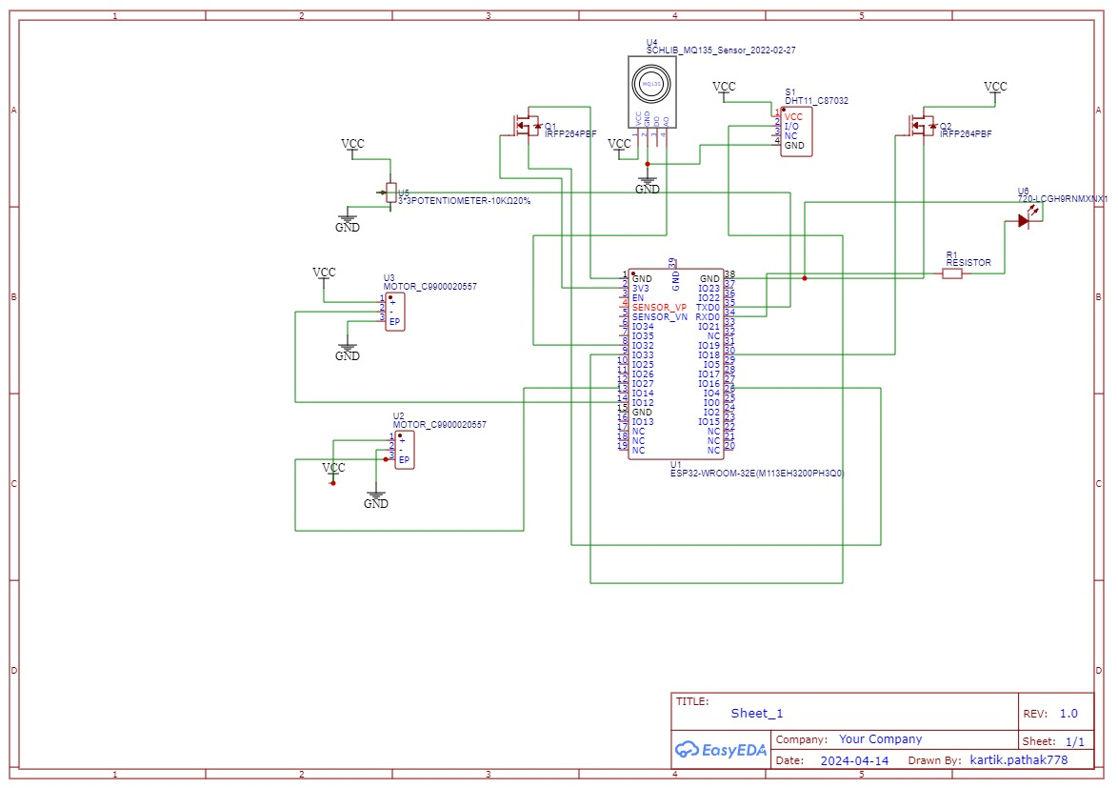

Slide 7




LDR Sensors
Passive electronic sensor used to detect light.
Sensor Used
DHT 22 Sensors
Briefly elaborate about sensors we have integrated in our circuit
Measures the surrounding air and spits out a digital signal on the data pin
IR Sensors
Measures the heat of an object as well as detects the motion

Slide 8
Components Used
ESP 32
DC Motors
GPB Board
Servo Motors
LEDs

Slide 9
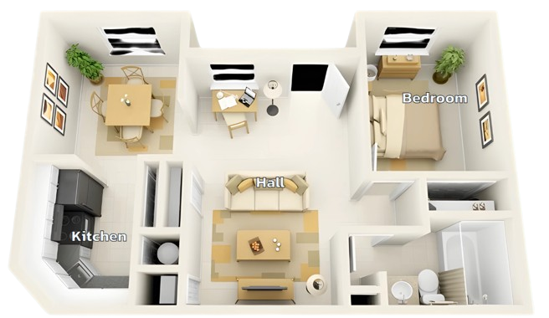
User Interface

Slide 10
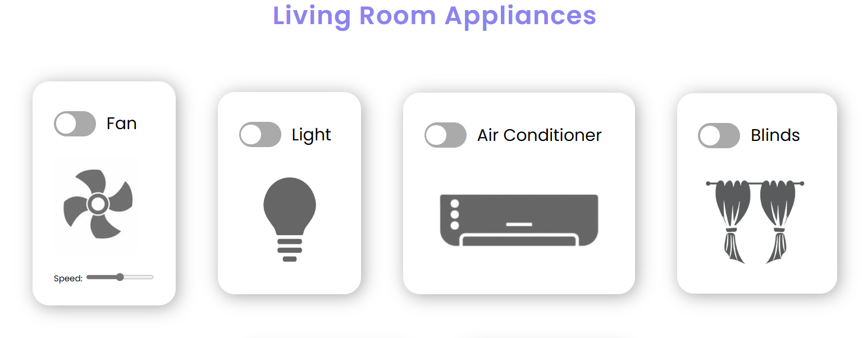

Slide 11
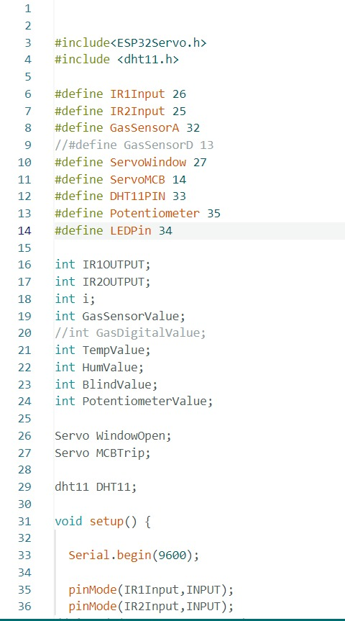
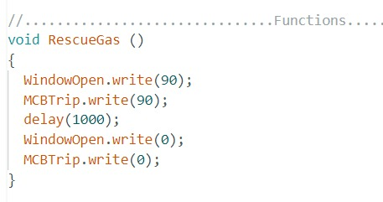

Slide 12
Goals
The primary goal of smart home automation is to ease daily life
Aim to reduce energy consumption and lower utility bills
Enhances security and provide real time alerts
Our Goals
and Vision
Vision
Optimizing energy usage and make a user friendly interface
Saving money but also benefiting environment
Sending notification if smoke alarm detects potential fire

Slide 13
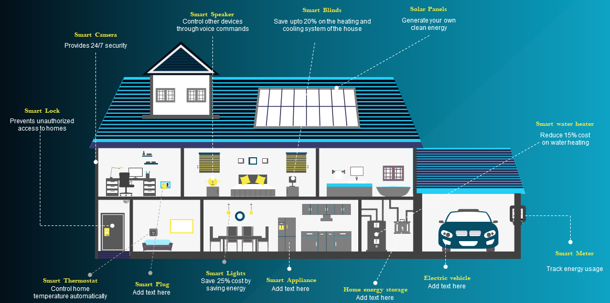

Slide 14
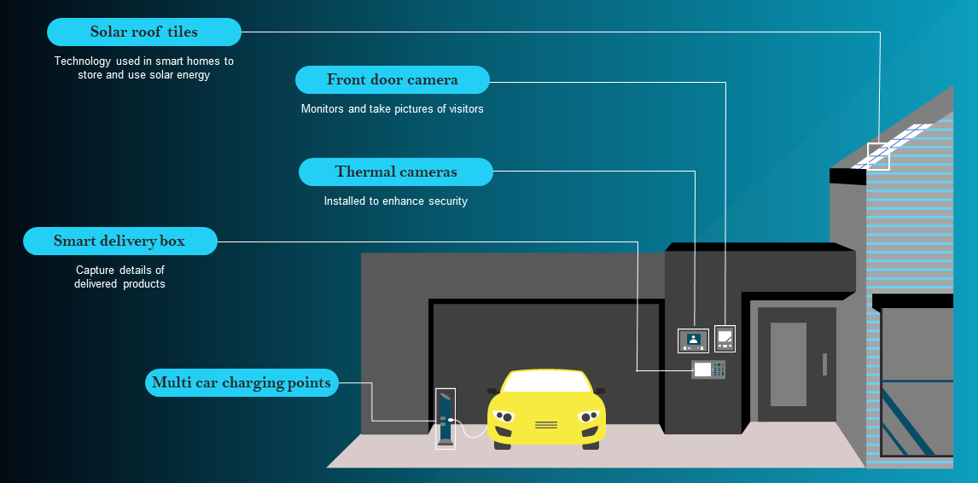

Slide 15

About Us
Om Mukherjee
Electronics, VJTI
Karthikey Pathak
Electrical, VJTI
Vishal Mutha
Electrical, VJTI
Piyush Patle
Electrical, VJTI

